Slide 1
4+1 View Model of Software Architecture
Lecture 4

Slide 2
Outline
Problem
Solution
4+1 view model
Logical view
Process view
Development view
Physical view
Scenarios
The Iterative process
Remarks

Slide 3
Problem
Arch. documents over-emphasize an aspect of development and do not address the concerns of all stakeholders
Various stakeholders of software system: end-user, developers, system engineers, project managers
Software engineers struggled to represent more on one blueprint, and so arch. documents contain complex diagrams

Slide 4
Architecture Views: Solution
A software architecture represents a complex design artifact. Not surprisingly then, like most complex artifacts, there are a number of ways of looking at and understanding an architecture.
The term “architecture views” rose to prominence in Philippe Krutchen’s 1995 paper on the 4+1 View Model. This presented a way of describing and understanding an architecture.

Slide 5
Solution
Using several concurrent views or perspectives, with different notations(Data/details/information) each one addressing one specific set for concerns
“4+1” view model presented to address large and challenging architectures

Slide 6
4+1 View Model of Architecture
End user
Logical view
Development view
Programmers
& software managers
Scenarios
Process View
Physical View
Integrator
System Engineer
Notes:
The architecture in fact partially evolved from these scenarios as well as
The model is rather generic, and other notations and tools can be used, other design methods can be used especially for the logical and process decompositions
For each view, the architects can pick a certain architectural style
Similar views in UML
Use case view> - Encompass the use cases that describe the behavior of the system as seen by its end users, analysts, and testers
Design view - Encompass the classes, interfaces, and collaborations that form the vocabulary of the problem and its solution
Process view - Encompass the threads and processes that form the system's concurrency and synchronization mechanisms
Implementation view - Encompass the components and files that are used to assemble and release the physical system
Deployment view - Encompass the nodes that form the system's hardware topology on which the system executes

Slide 7
Logical View
(Static view)
Viewer: End-user
considers: Functional requirements- What the system should provide in terms of services to its users.
The logical view is concerned with the functionality that the system provides to end-users. UML Diagrams used to represent the logical view include
Class diagram,
Communication diagram,
Sequence diagram.

Slide 8
Process View
(The process decomposition/ runtime view)
viewer: Integrators
considers: The Process view is concerned with the runtime aspects and descriptions of subsystems.
The process view deals with the active aspects of the system, explains the system processes and how they communicate, and focuses on the runtime behavior of the system.

Slide 9
Process View cont’d
The process view addresses concurrency, distribution, integrators, performance, and scalability, etc.
UML Diagrams to represent process view include the
Activity diagram
Notes:
Concurrency means multiple computations are happening at the same time
Scalability is an attribute that describes the ability of a process, network, software or organization to grow and manage increased demand.

Slide 10
Development View
(Developer’s view/ component design view)
Viewer: Programmers and Software Managers
considers: software module organization
Hierarchy of Components,
software management,
reuse,
constraints of tools, …

Slide 11
Development View Cont’d
The development view demonstrate a system from a programmer's perspective and is concerned with software management.
This captures the internal organization of the software components, typically as they are held in a development environment or configuration management tool.
This view is also known as the implementation view.
UML Diagrams used to represent the development view include
Component diagram
The Package diagram.
Notes:
For example, the depiction of a nested package and
class hierarchy for a Java application would represent the development view of
an architecture.

Slide 12
Physical View
(Mapping the software to the Hardware)
Viewer: System Engineers
Considers: Non-functional req. regarding to underlying hardware (Topology, Communication)
It is concerned with the topology of software components, as well as the physical connections between these components.
Notes:
for example, how the database and web servers for an application are distributed across a number of
server machines.

Slide 13
Physical View Con’t
This view is also known as the deployment view.
UML Diagrams used to represent physical view include the Deployment diagram.

Slide 14
4+1 View Model of Architecture
End user
Logical view
Development view
Programmers
& software managers
Scenarios
Process View
Physical View
Integrator
System Engineer
Notes:
The architecture in fact partially evolved from these scenarios as well as
The model is rather generic, and other notations and tools can be used, other design methods can be used especially for the logical and process decompositions
For each view, the architects can pick a certain architectural style
Similar views in UML
Use case view> - Encompass the use cases that describe the behavior of the system as seen by its end users, analysts, and testers
Design view - Encompass the classes, interfaces, and collaborations that form the vocabulary of the problem and its solution
Process view - Encompass the threads and processes that form the system's concurrency and synchronization mechanisms
Implementation view - Encompass the components and files that are used to assemble and release the physical system
Deployment view - Encompass the nodes that form the system's hardware topology on which the system executes

Slide 15
Scenarios
(Putting it all together)
Viewer: All users of other views and Evaluators.
Considers: System consistency, validity
Help demonstrate and validate the document
Help Architect during the architecture design
The description of an architecture is demonstrated using a small set of use cases, or scenarios which become a fifth view.

Slide 16
Scenarios Con’t
The scenarios describe sequences of interactions between processes.
They are used to identify architectural elements
And to illustrate and validate the architecture design.
They also serve as a starting point for tests of an architecture model.

Slide 17
Correspondence between views
Views are interconnected.
Start with Logical view (Req. Doc) and Move to Development or Process view and then finally go to Physical view.
Two strategy to analyse level of harmony:
Inside-out: starting from Logical structure
Outside-in: starting from physical structure
Notes:
the Harmony process consists of a set of best practices that achieve most of the goals of this (and other standards) and the process content contains explicit mappings from the standard to the process elements to show how compliance can be achieved.

Slide 18
The Iterative process
Not all software arch. Need all views.
A scenario-driven approach to develop the system
Documentation:
Software architecture document
Software design guidelines

Slide 19
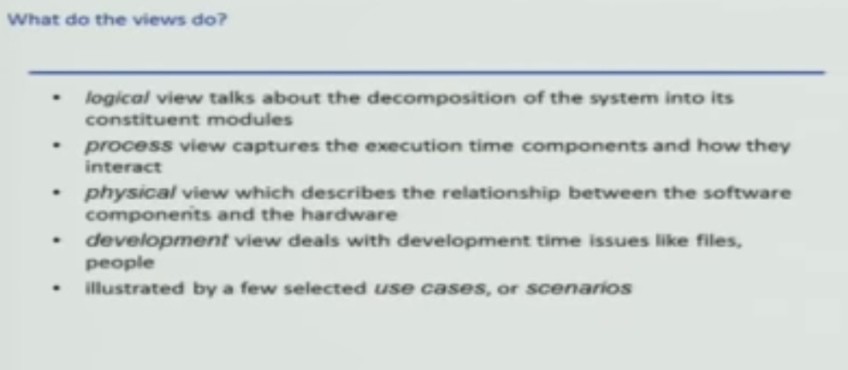
Summary

